Slide 1

My iDTech Experience
By: Gerardo Bote

Slide 2
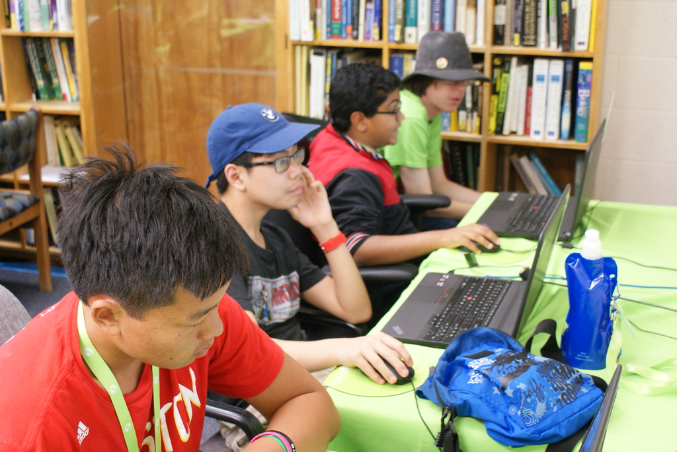
Rice University
Java Programming
July 13th, 2015 – July 17th, 2015

Slide 3
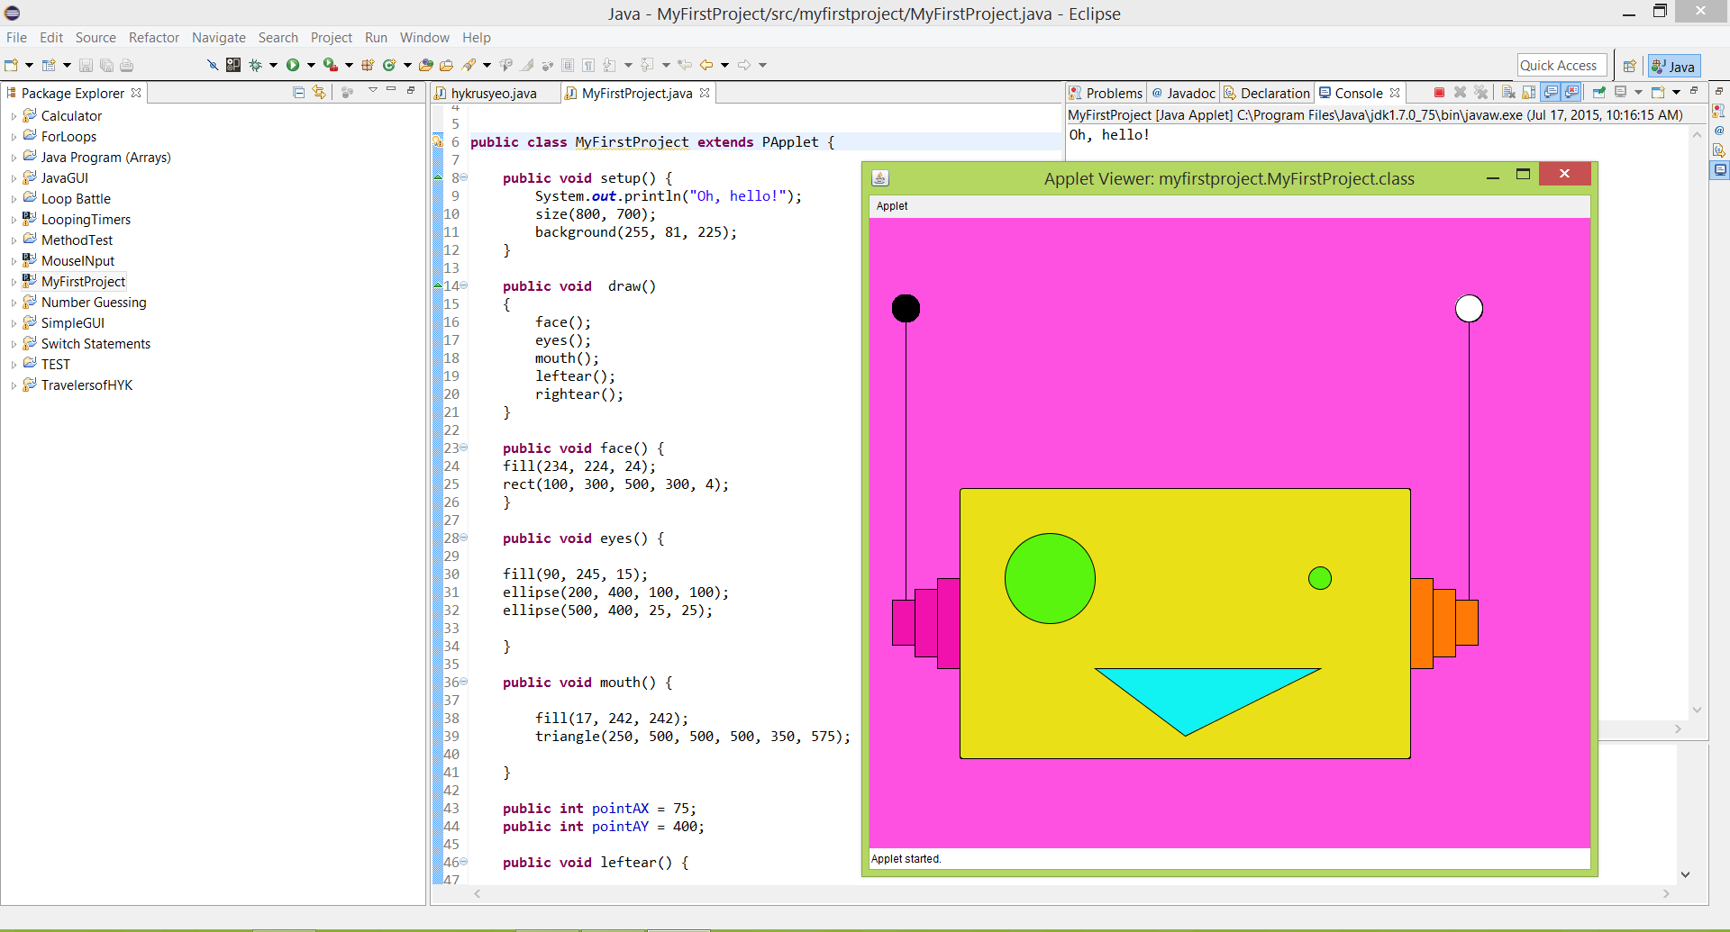
My 1st Applet Project
This was my very first project that had to deal with something called an applet. These are like the baby versions of applications. It involved methods that work with what make what it is. For example, public void draw() is what draws the face part, including color. It takes lines of code to do draw this. These are what I used to draw this:
public void face() {
fill(234, 224, 24);
rect(100, 300, 500, 300, 4);
}
public void eyes() {
fill(90, 245, 15);
ellipse(200, 400, 100, 100);
ellipse(500, 400, 25, 25);
}
public void mouth() {
fill(17, 242, 242);
triangle(250, 500, 500, 500, 350, 575);
}

Slide 4
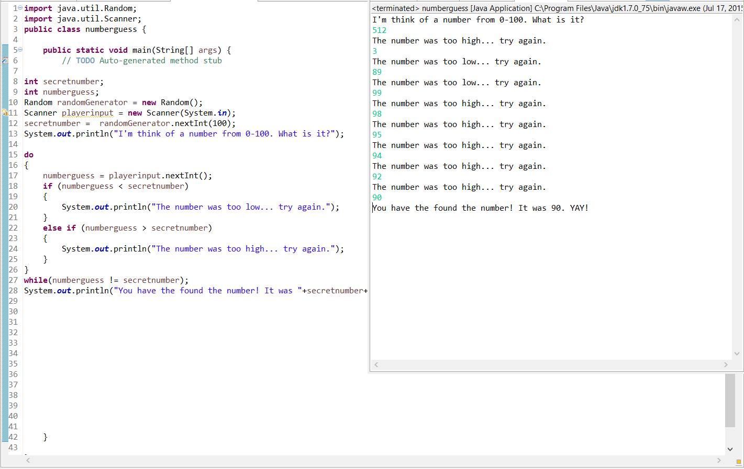
While & Do-While Loops
While Loops are loops that repeat until the condition is met. For example, if the player's health is below zero, a certain action like moving around will stop (hence Minecraft). This is very important if you do not want to repeat or make a long code. On the other hand, Do-While Loops are vice versa; they actually do the action first then check. This is very specific indeed when making RPG Games.

Slide 5
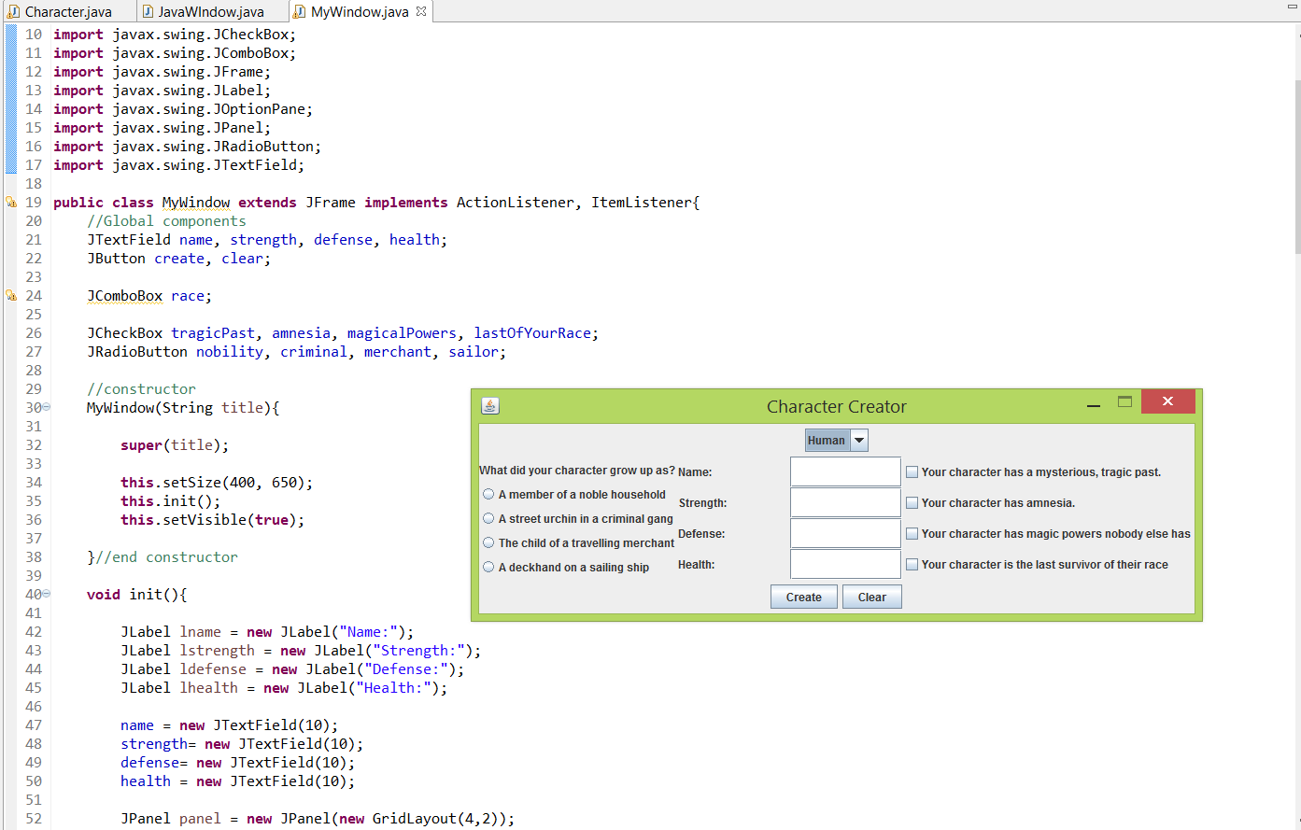
Simple Java GUI
Commands are used here to make borders and player inputs. I did not include it, but when you enter the information it tells you again in another window what you put. There are what they called radio boxes that has those little circles and the choices on the right. Sometimes, if you choose all 4 square choices, it will open up a window that will say that you're a Mary Sue. Those are people with such an interesting and weird past, making them WAY too unique. Also, if you choose your class (Human, orc, elf) it will enter some info for you in the input boxes. Also, GUI stands for Graphical User Interface.

Slide 6

Java Final Project
It is an adventure game that was inspired by my best friend since 4th grade. It has a timeline that I hope is not too confusing and I really hope that you like it. It has while loops, for loops, if & else statements, and others! I really hope that you enjoy it. (Unless I already showed it. Then you can have some praise on my work.
).

Slide 7
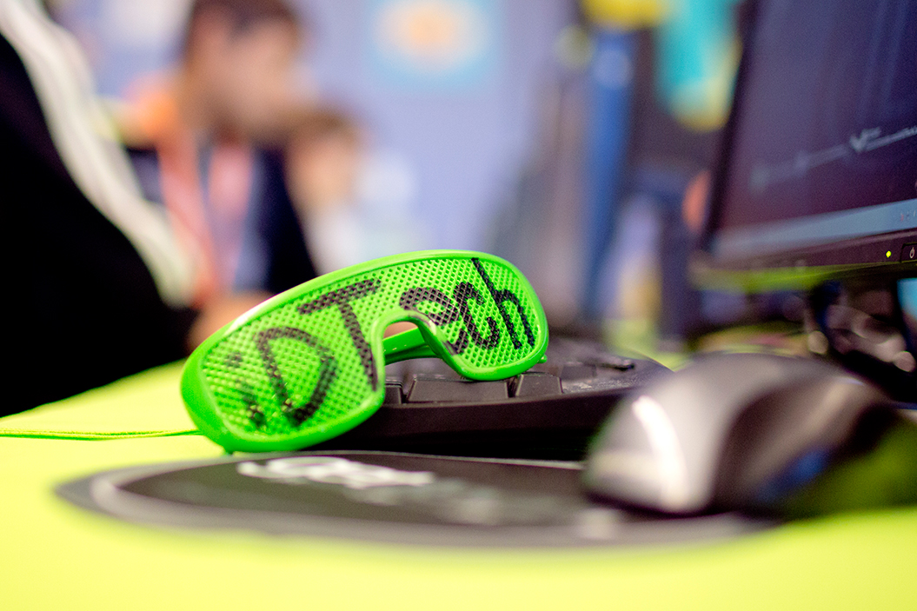
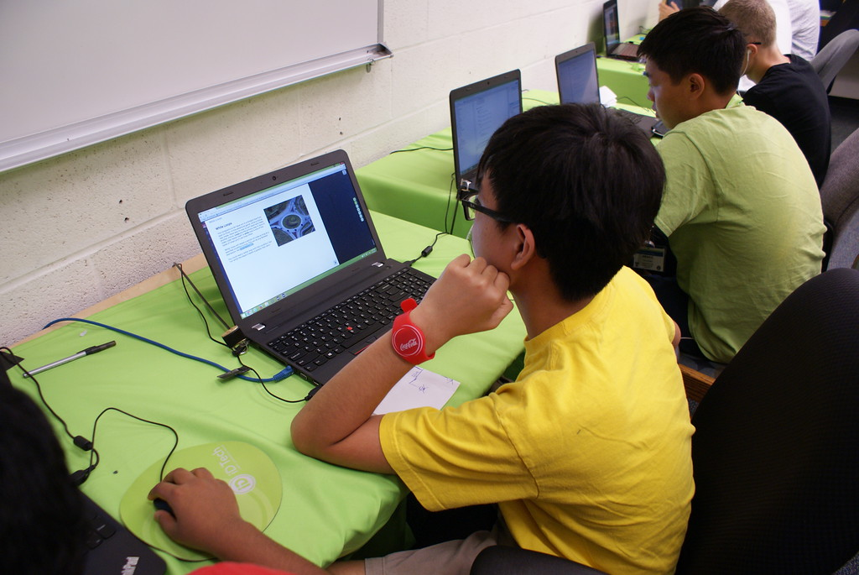
Favorite Camp Memory
I really do not have a favorite memory from this camp because there way too many!
Sometimes, we play funny board games, or sometimes we have the most rapid and hardcore PC games (TF2).
I really hope that I can visit this camp next time and use this an opportunity to my future! :)

